Slide 1

MAJOR PROJECT EXECUTION REVIEW PRESENTATION
TITLE – Blockchain Forensics: Bitcoin Transaction Analysis Framework
Batch no - 03
1.K.Rajinikar Reddy - 21R11A6231
2. C.B.Malathi - 21R11A6213
3. B.Hari Shankar - 21R11A6209
Under the Guidance of
Dr.A.Shraban Kumar
Associate Professor(CSE-CS)

Slide 2
INDEX PAGE
Sl.No | Topic Name | Slide no
1 | Abstract | 3
2 | Problem Statement | 4
3 | Existing System | 6
4 | Proposed System | 7
5 | System Architecture | 8
6 | UML Diagrams | 9
7 | Methodology | 15
8 | Execution | 17
9 | Conclusion | 23

Slide 3
ABSTRACT
The rise of blockchain-based cryptocurrencies, notably Bitcoin, has led to an alarming surge in their malicious exploitation for money laundering activities on the dark web.
In response, the paper presents an innovative Bitcoin transaction network analytic method designed to blockchain forensic investigations, leveraging an extended safe Petri Net.
The proposed Bitcoin transaction network analytic method provides a reliable forensic investigation model along with a prototype platform which is beneficial for financial security.

Slide 4
PROBLEM STATEMENT
Previous systems predominantly focus on Bitcoin addresses and flow analysis, neglecting other crucial aspects such as transaction structure and behavior features.
This narrow focus limits the ability to comprehensively trace and analyze suspected transactions.
Early studies of Bitcoin transaction analysis mainly focused on Bitcoin address cluster analysis, which aims to cluster addresses.
It is difficult to find their addresses to analyze their transaction features, which limits their practical applicability due to the lack of known samples.

Slide 5
OBJECTIVE
The project uses Petri nets to model Bitcoin transactions and analyze the Bitcoin Transaction Network (BTN) to track and detect illegal payments through address patterns and transaction flows.
Blockchain is utilized in this project to securely and transparently record Bitcoin transaction data, enhancing data integrity and enabling reliable forensic analysis.
The project enhances tracking of potentially unlawful financial activities by applying pattern-matching rules to identify deposit and withdrawal transactions, flagging suspected addresses with invalid or missing information.

Slide 6
EXISTING SYSTEM
Bitcoins are not usually associated with their user identities, such as user names, residential addresses, or other personal identification information.
Due to this pseudonymous nature, Bitcoin is falsely regarded as a form of anonymous currency in the Internet, and is falsely believed to facilitate untraceable transactions during illegal trades.
Bitcoin has soon been used by illegal activities, such as illegal drugs and weapon trade etc.
DISADVANTAGES:
Limited Focus on Addresses and Flow
Lack of Comprehensive Transaction Analysis
Insufficient Identification of Suspected Addresses
Insufficient Validation through Real-Life Case Studies

Slide 7
PROPOSED SYSTEM
The project proposes an extended safe Petri net based model to simulate the Bitcoin transactions, which is called Bitcoin Transaction Net (BTN).
Its structural features and dynamic semantics are used to describe both the static and dynamic features of Bitcoin transactions, respectively.
The project proposes a set of match rules to find transactions and obtain suspected addresses, based on the combinations of match rules.
ADVANTAGES:
1. Comprehensive Transaction Analysis
2. Inclusion of Transaction Structure and Behavior Features
3. Integration of Bitcoin Gene into Petri Net Transitions
4. Prototype Platform for Forensic Investigation

Slide 8
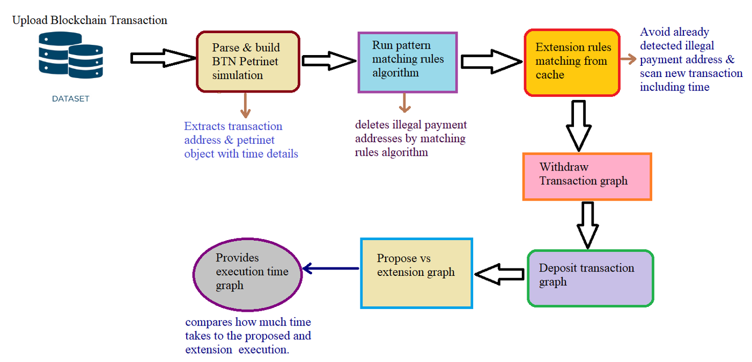
SYSTEM ARCHITECTURE

Slide 9
UML DIAGRAMS

Slide 10
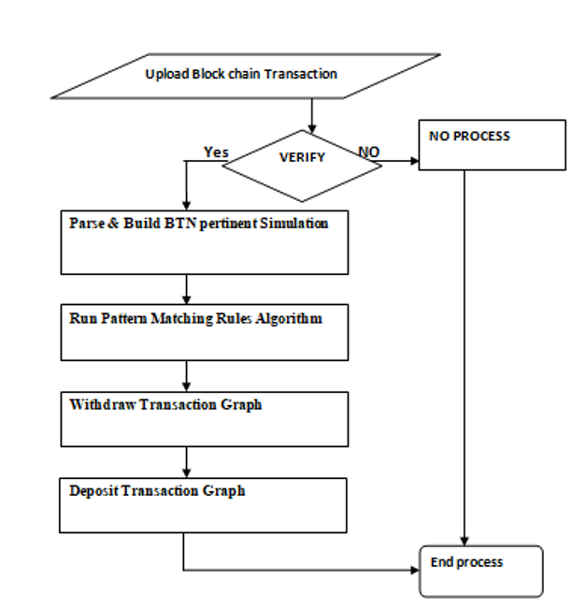
DATA FLOW DIAGRAM

Slide 11
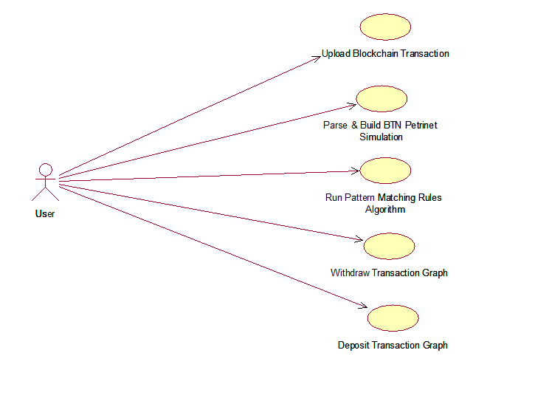
USE CASE DIAGRAM

Slide 12
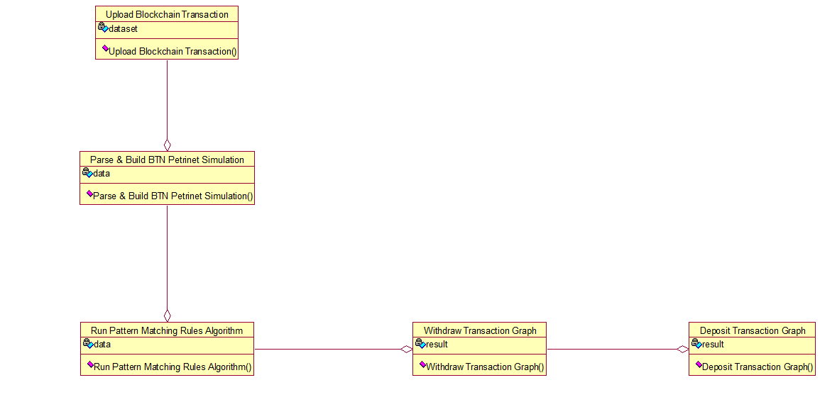
2255
CLASS DIAGRAM

Slide 13
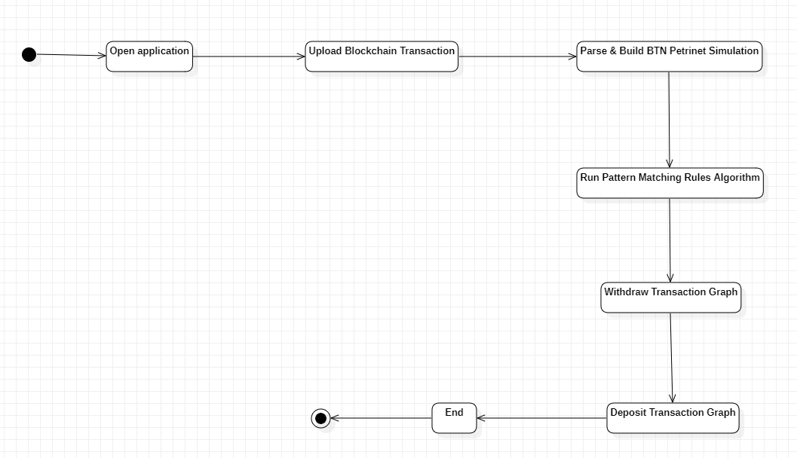
ACTIVITY DIAGRAM

Slide 14
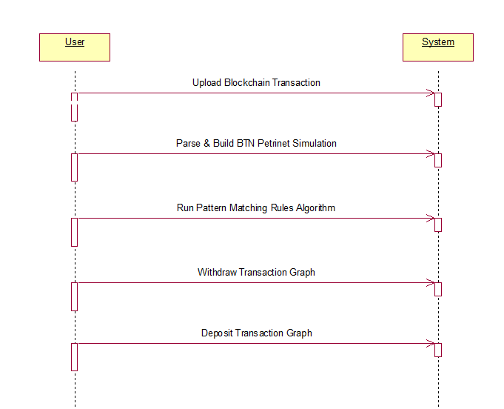
SEQUENCE DIAGRAM
21/04/2025

Slide 15
METHODOLOGY
Upload Blockchain Transaction: This module involves the process of uploading blockchain transaction data into the system. It's the initial step where transaction information from the Bitcoin network is acquired and made available for analysis. This data forms the foundation for the forensic investigation.
Parse & Build BTN Petrinet Simulation: In this module, the uploaded blockchain transaction data is parsed and transformed into a Petri net simulation specifically tailored to model the Bitcoin Transaction Network (BTN). Petri nets are mathematical models that help represent and analyze complex systems like Bitcoin transactions.

Slide 16
METHODOLOGY
Run Pattern Matching Rules Algorithm: Once the Petri net simulation is in place, the system runs a pattern matching rules algorithm. This algorithm is designed to scan the transaction data for specific patterns and characteristics that may indicate potentially unlawful financial activities.
Withdraw Transaction Graph: This module deals with the visualization and analysis of withdrawal transactions within the Bitcoin network.
Deposit Transaction Graph: It generates a visual representation of the deposit transactions in the Bitcoin network, helping investigators analyze the flow of funds and identify patterns associated with deposits.

Slide 17
EXECUTION

Slide 18
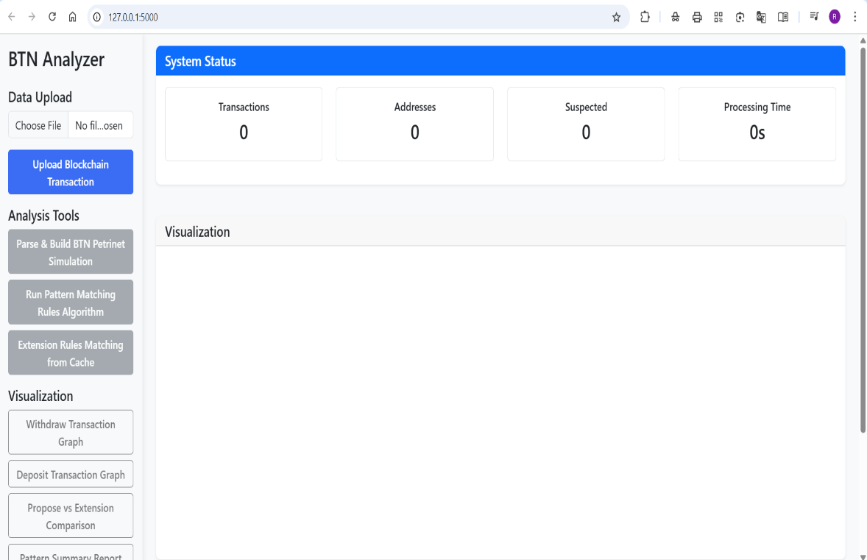
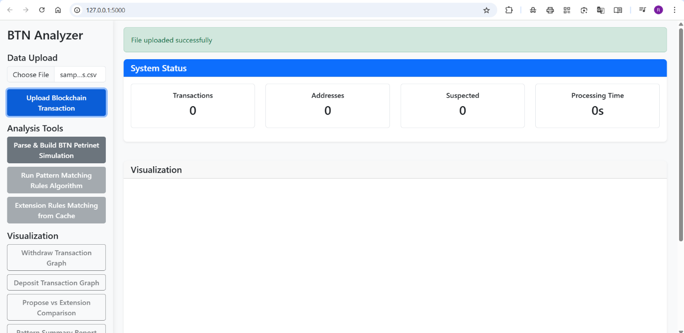
Step 1: Main Dashboard
Step 2: Dataset Uploaded

Slide 19
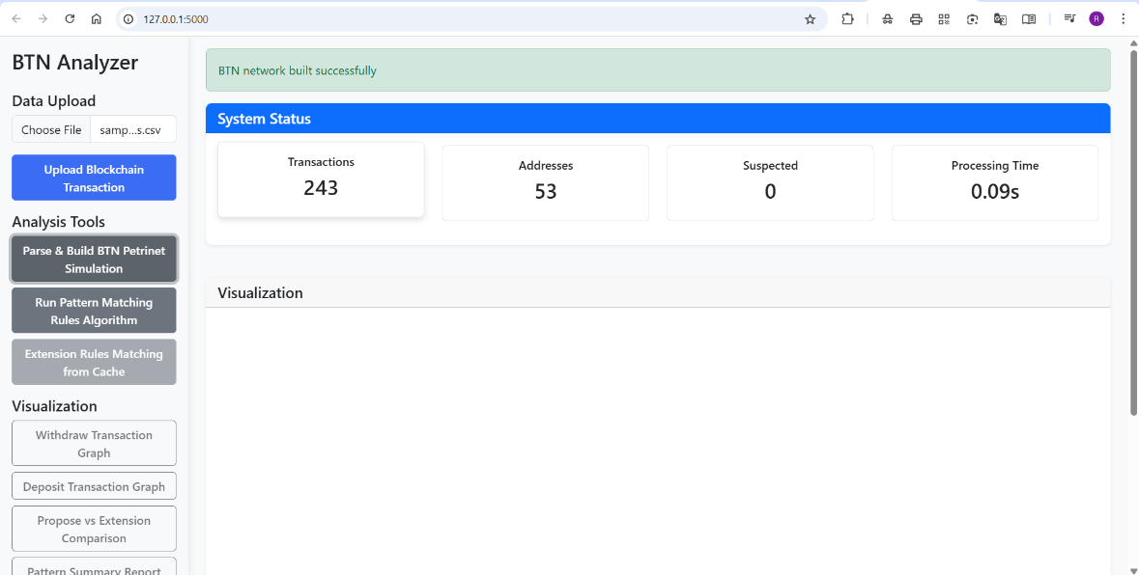
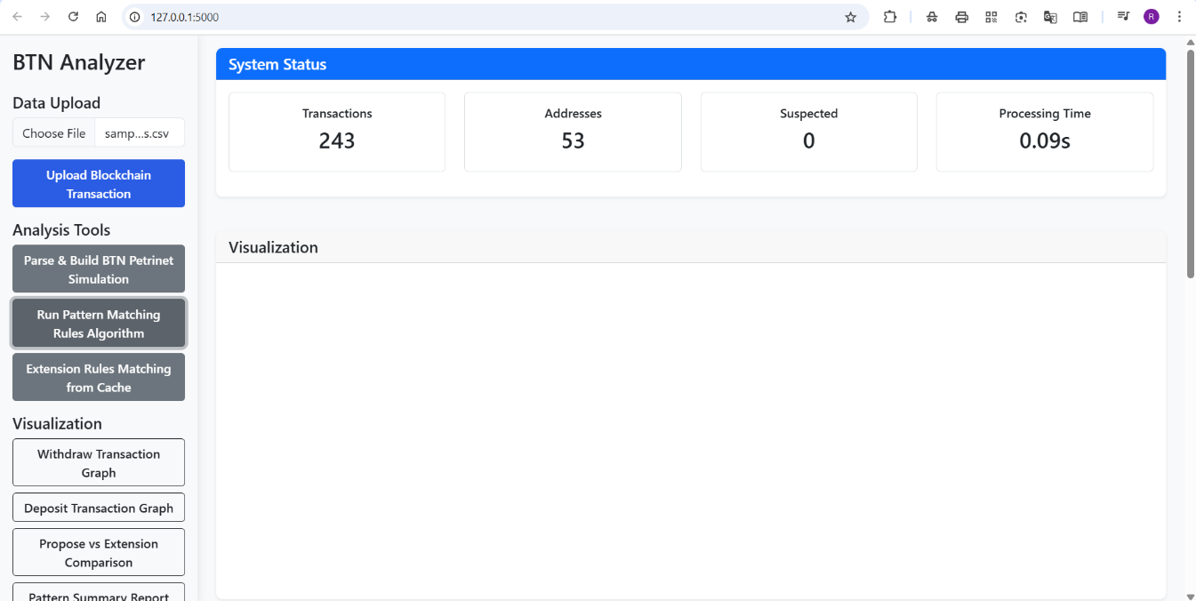
Step 3: Parsing BTN
Step 4: Running Patterns

Slide 20
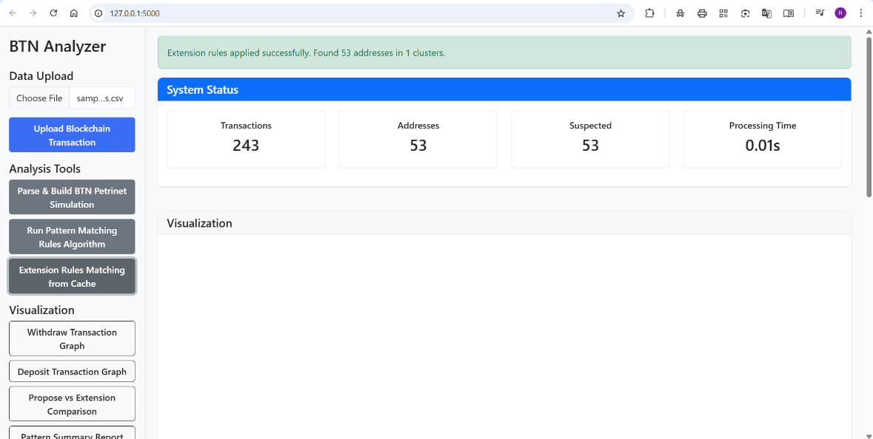
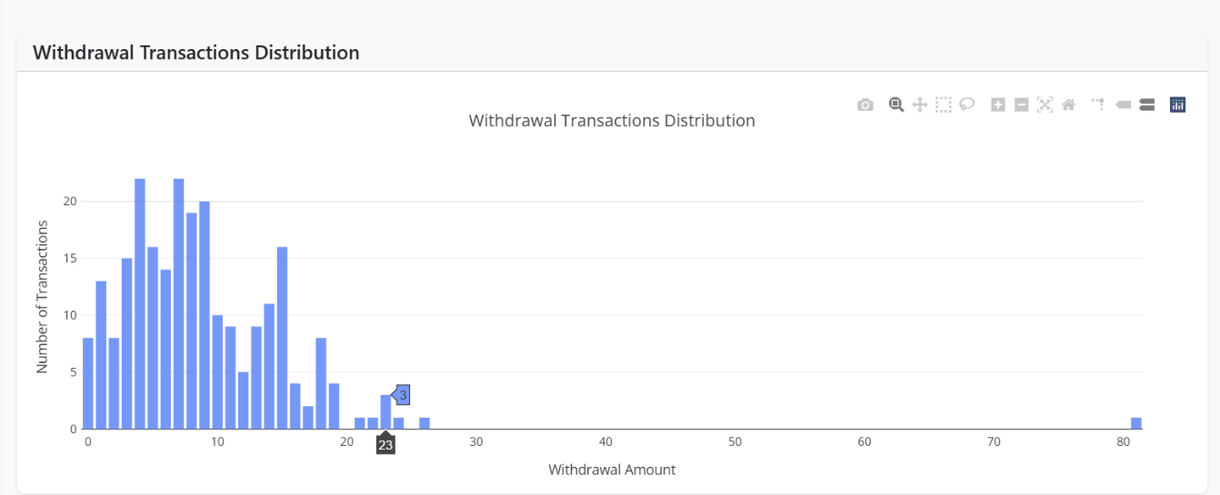
Step 5: Extension Rules Matching From Cache
Step 6: Withdraw Transaction Graph

Slide 21
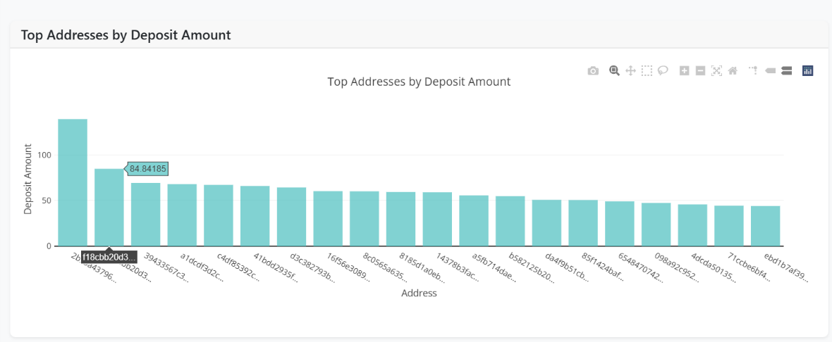
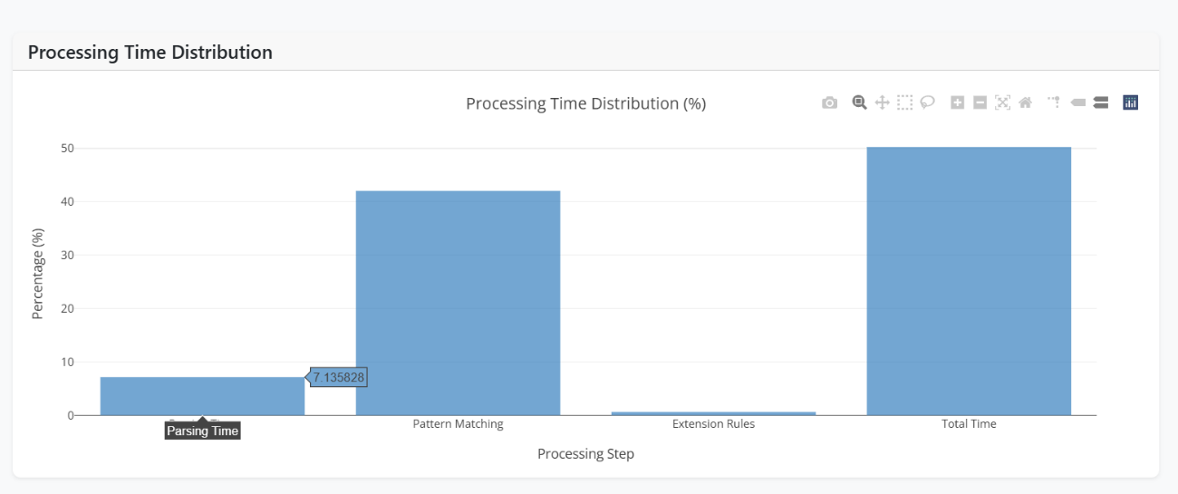
Step 7: Deposit Transaction Graph
Step 8: Processing Time Distribution

Slide 22
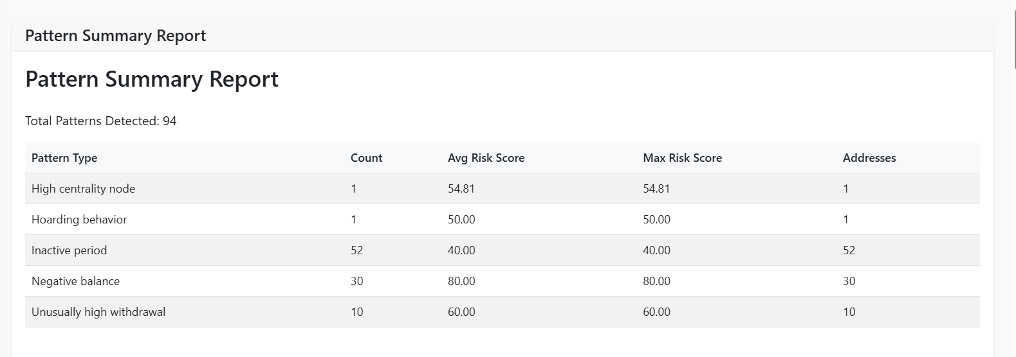
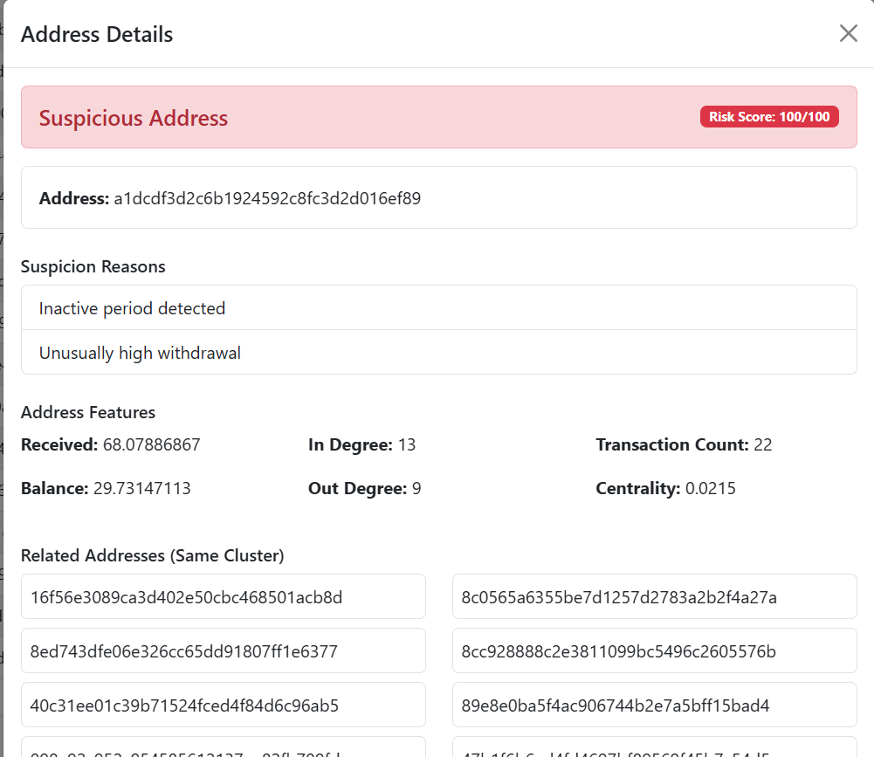
Step 9: Pattern Summary Report
Step 10: Addresses Detailed Information

Slide 23
CONCLUSION
The utilization of Petri nets allows for efficient modeling and simulation of Bitcoin transactions, providing a clear representation of address interactions and state changes. This facilitates a systematic analysis of the transaction network. Implementing pattern matching rules enhances the identification of suspicious transactions and addresses.
By accurately identifying suspected addresses and patterns, authorities and analysts can focus their efforts on potentially unlawful financial transactions, ultimately improving the security and integrity of the blockchain ecosystem.

